Slide 1
Current, voltage and resistance

Slide 2
Electrical circuits
In electrical circuits there are three factors that need to be considered when discussing the transfer of electrical energy within a circuit.
Current: I - the rate at which electrons pass a point in a circuit.
Voltage: V - the electrical energy supplied to the electrons, produced by a battery or mains electrical supply.
Resistance: R - the degree to which electron flow is impeded or slowed down by the circuit itself.

Slide 3
Electric current
This is the rate at which electric charge passes a point in a circuit. The path an electric current follows, measured in Amperes or Amps, with the symbol "A" for Amps.
Named after the Frenchman, Andre Marie Ampere (1775-1836)
Current is given the symbol I and is measured in Amps, A.
For example the current in the circuit, I is 3A.
1 Amp, 1 coulomb of charge passes that point each second.
Equivalent of 6 250 000 000 000 000 000 (six thousand two hundred and fifty million billion) electrons passing each second.

Slide 4
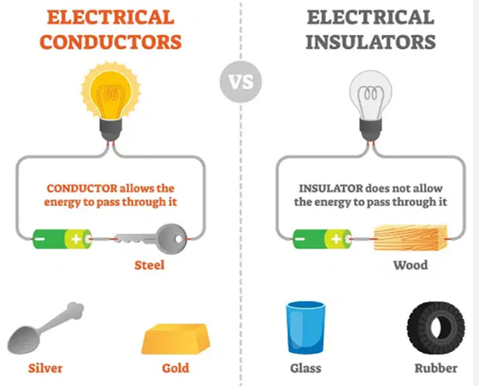
Electric Conductor and Insulators
An electrical conductor is a material through which charge can flow easily.
all metals, and the non-metal carbon.
An electrical insulator is a material through which charge cannot flow easily.
other non-metals, and gases, do not allow current to flow, and are called electrical insulators

Slide 5
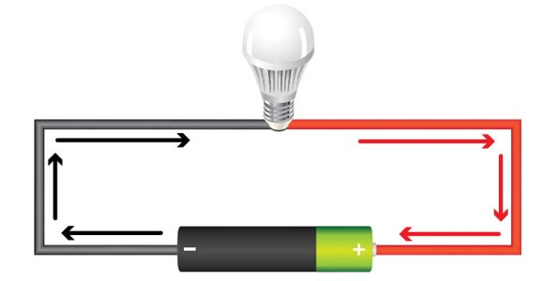
Voltage
Voltage is the pressure from an electrical circuit's power source that pushes charged electrons (current) through a conducting loop, enabling them to do work such as illuminating a light.
Voltage = pressure, and it is measured in volts (V). The term recognizes Italian scientist Alessandro Volta (1745-1827), inventor of today's household battery.

Slide 6
What is potential difference
Voltage and the term "potential difference" are often used interchangeably.
Potential difference might be better defined as the potential energy difference between two points in a circuit.
The amount of difference (expressed in volts) determines how much potential energy exists to move electrons from one specific point to another.
The quantity identifies how much work, potentially, can be done through the circuit.

Slide 7
What is Ohm’s Law
Ohm's Law states that the voltage V across a conductor of resistance R is proportional to the current I passing through the resistor.
The relationship is written as V = R I
Formula used to calculate the relationship between voltage, current and resistance in an electrical circuit.
The quantity identifies how much work, potentially, can be done through the circuit.
Georg Simon Ohm, a German scientist was the first to verify Ohm’s law experimentally.

Slide 8
What is Ohm’s Law
To Find out the voltage in electrical circuit by applying ohm’s law
V= IxR
Voltage (V)= Current (I) x Resistance (R).

Slide 9
What is Ohm’s Law
To Find out the current in electrical circuit by applying ohm’s law
I= V/R
Current (I) = Voltage (V) / Resistance (R).

Slide 10
What is Ohm’s Law
To Find out the resistance in electrical circuit by applying ohm’s law
R= V/I
Resistance (R)= Voltage (V) / Current (I) =

Slide 11
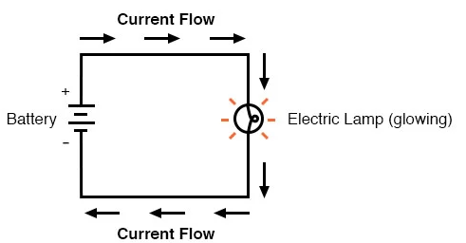
Analysing Simple Circuits with Ohm’s Law
There is only one source of voltage (the battery, on the left).
One source of resistance to current (the lamp, on the right).
This makes it very easy to apply Ohm’s Law. If we know the values of any two of the three quantities (voltage, current, and resistance) in this circuit, we can use Ohm’s Law to determine the third.

Slide 12
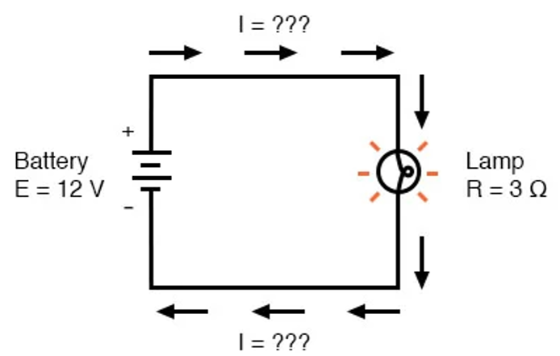

Analysing Simple Circuits with Ohm’s Law
In this first example, we will calculate the amount of current (I) in a circuit, given values of voltage (E) and resistance (R):.
.
What is the amount of current (I) in this circuit?

Slide 13
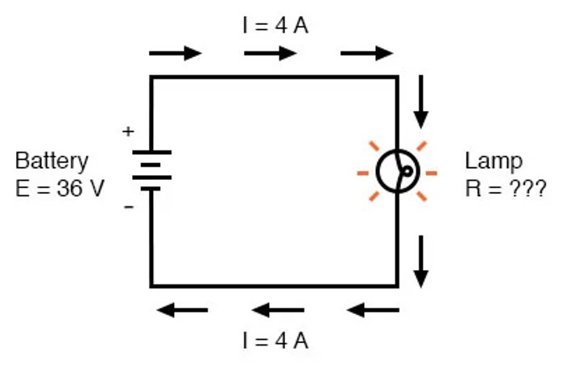
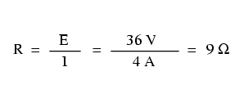
Analysing Simple Circuits with Ohm’s Law
In this second example, we will calculate the amount of resistance (R) in a circuit, given values of voltage (E) and current (I):.
.
What is the amount of resistance (R) offered by the lamp?

Slide 14
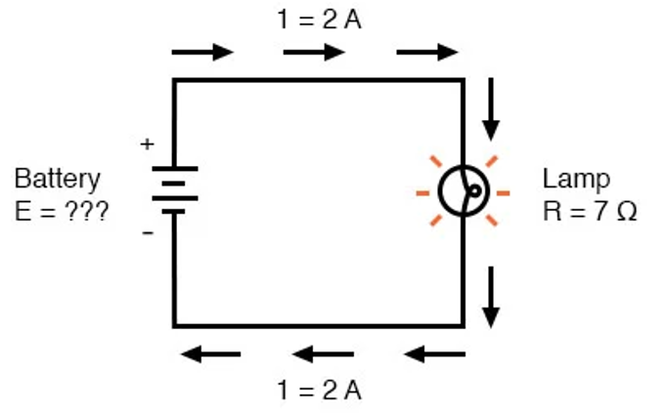
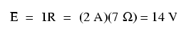
Analysing Simple Circuits with Ohm’s Law
In the last example, we will calculate the amount of voltage supplied by a battery, given values of current (I) and resistance (R):.
.
What is the amount of voltage provided by the battery?

Slide 15
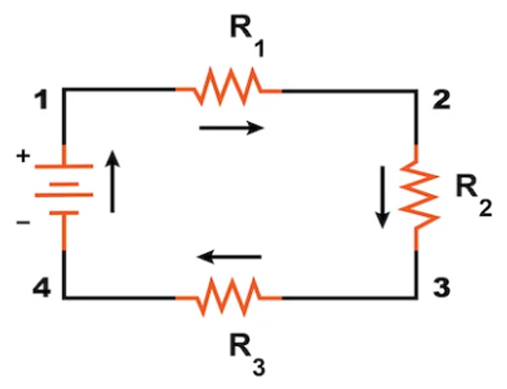
Series and Parallel Circuits
The definition of a series circuit is a circuit where the components are connected end-to-end in a line as illustrated in Figure.
Series circuit have the same current flowing through all connected resistance, There is only one path for the current to flow.
Series Circuit is
ONE Electrical Pathway

Slide 16
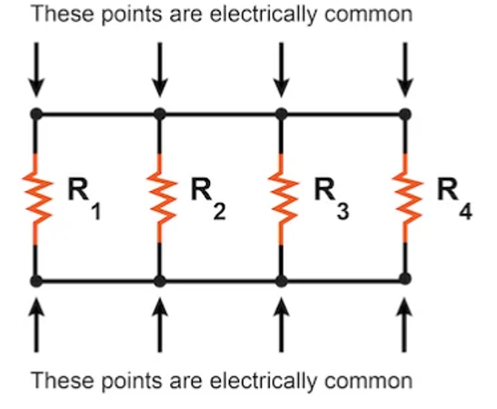
Series and Parallel Circuits
Parallel circuit is a circuit where all components are connected across each other’s leads as shown in Figure.
In parallel circuit, there are multiple two sets of electrically common points. There are many paths for current flow, but only one voltage across all components.
Parallel Circuit is
Multiple Electrical Pathway

Slide 17
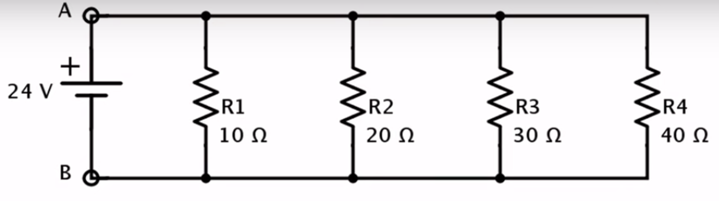



Parallel Circuits
R_{total} =$\frac{1}{R1}+\frac{1}{R2}+\frac{1}{R3}+\frac{1}{R4}$
R_{total} =$\frac{1}{20}+\frac{1}{20}+\frac{1}{30}+\frac{1}{40}=0.208$
R_{total} =$\frac{1}{0.208}=4.8$Ω

